Slide 1
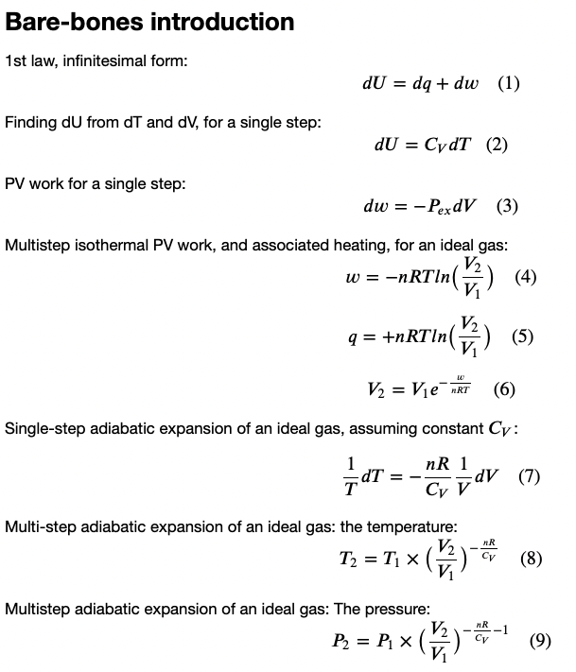
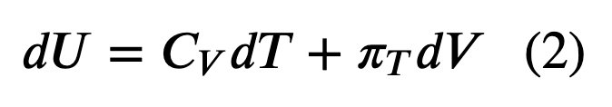
Recap
What we’ve done so far this week
Heat, work, and the 1st Law
Explored how that relates to the behavior of gases as they expand & contract
Constructed Carnot cycles
Today
Do some analytical (blackboard) work

Slide 2

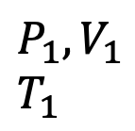




The Carnot cycle is a theoretical heat engine that converts heat into work
$$T_{H}$$
The “working fluid” of a Carnot is an ideal gas
$$P_{ex}$$
$$P_{ex}$$
|Q_{C}|
$$P_{2},V_{2}$$
$$T_{2}$$
$$P_{1},V_{1}$$
$$T_{1}$$
$$T_{C}$$

Slide 3
In practice, thermoelectric power plants use similar ideas (but the working fluid is water)
$$T_{H}$$
|Q_{C}|
$$T_{C}$$

Slide 4
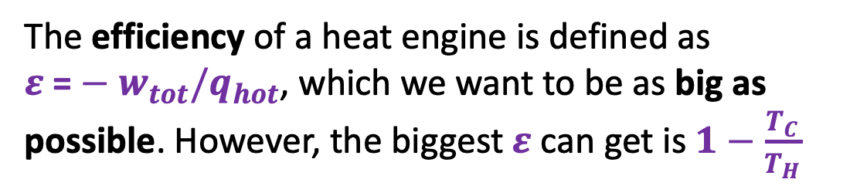
Heat engine efficiency
$$T_{H}$$
The efficiency of a heat engine is defined as ${ε \text{=}−w}_{tot}/q_{hot}$, which we want to be as big as possible. However, the biggest $ε$ can get is $1−\frac{T_{C}}{T_{H}}$
|Q_{C}|
$$T_{C}$$

Slide 5
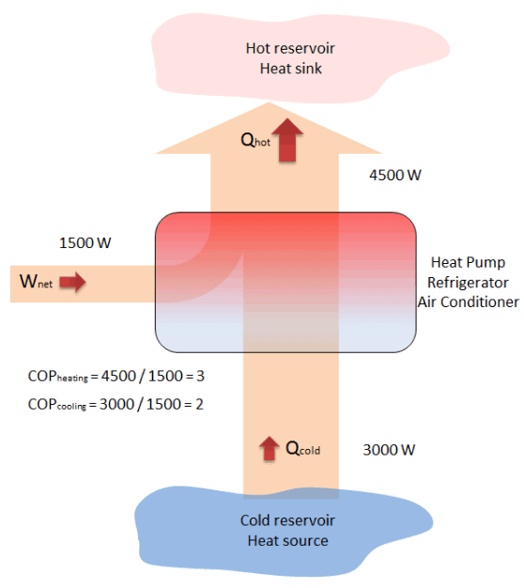


Heat engines vs heat pumps
A heat pump’s job is to use work (electricity) to move heat from a cold place (like outside) to a warm place (your house).
A heat engine’s job is to convert heat from a hot place (like a furnace) into work (electricity), dumping the waste heat into a cold place (the ocean or something).
$$T_{H}$$
$$T_{C}$$
https://www.thermal-engineering.org/what-is-coefficient-of-performance-cop-heat-pump-definition/

Slide 6
1. Draw arrows from the five items on the left (T_{H}, etc.) to places on the right.
$$T_{H}$$
$$T_{C}$$

Slide 7








2. Derive this expression for isothermal PV work
$w=−nRTln(\frac{V_{2}}{V_{1}})$ ➔ $\frac{V_{2}}{V_{1}}=exp\left(−\frac{w}{nRT}\right)$
?
$$P_{ex}$$
$$P_{ex}$$
$$P_{2},V_{2}$$
$$P_{1},V_{1}$$
$$P_{ex}$$
$$P_{Ideal}=nRT/V$$
$$V_{1}$$
$$V_{2}$$

Slide 8

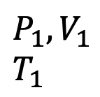


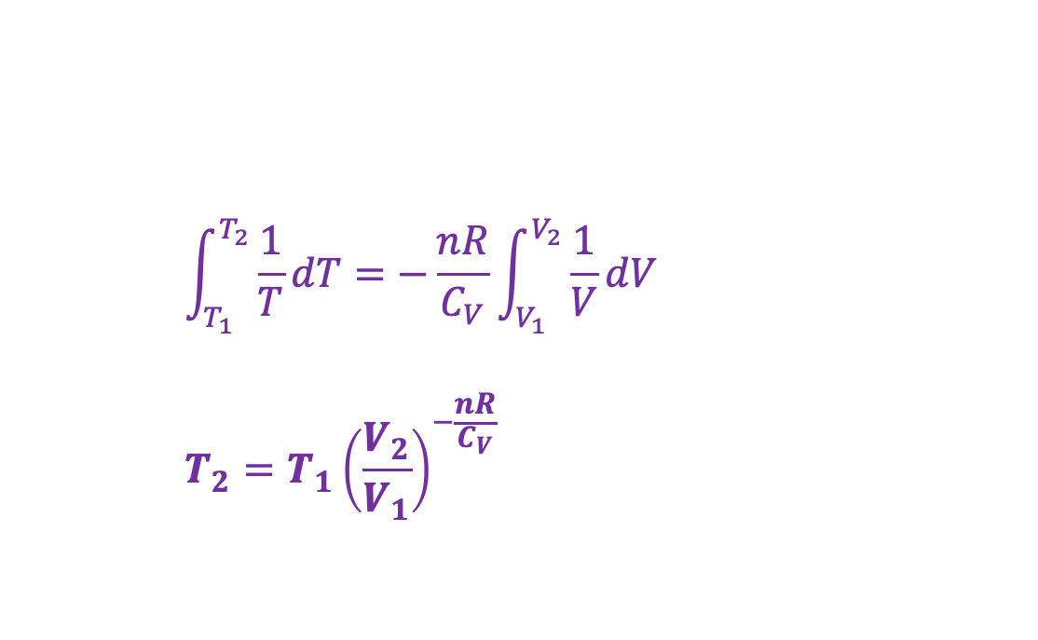



3. Derive this expression for multi-step adiabatic expansion of an ideal gas
$$\int_{T_{1}}^{T_{2}}{\frac{1}{T}dT}=−\frac{nR}{C_{V}}\int_{V_{1}}^{V_{2}}{\frac{1}{V}dV}$$
$$T_{2}=T_{1}{\left(\frac{V_{2}}{V_{1}}\right)}^{−\frac{nR}{C_{V}}}$$
$$U(T,V)$$
?
V
$$P_{ex}$$
T
$$P_{ex}$$
$$P_{2},V_{2}$$
$$T_{2}$$
$$P_{1},V_{1}$$
$$T_{1}$$
$$P_{ex}$$
No heat going in/out
Temperature is going down
$$P_{Ideal}=nRT/V$$
$$V_{1}$$
$$V_{2}$$

Slide 9

4. Derive this expression for multi-step adiabatic expansion of an ideal gas
$\frac{T_{2}}{T_{1}}={\left(\frac{V_{2}}{V_{1}}\right)}^{−\frac{nR}{C_{V}}}$
$P_{2}={P_{1}\left(\frac{V_{2}}{V_{1}}\right)}^{−\frac{nR}{C_{V}}−1}$
$$U(T,V)$$
?
V
$$P_{ex}$$
T
$$P_{ex}$$
$$P_{2},V_{2}$$
$$T_{2}$$
$$P_{1},V_{1}$$
$$T_{1}$$
$$P_{ex}$$
No heat going in/out
Temperature is going down
$$P_{Ideal}=nRT/V$$
$$V_{1}$$
$$V_{2}$$

Slide 10
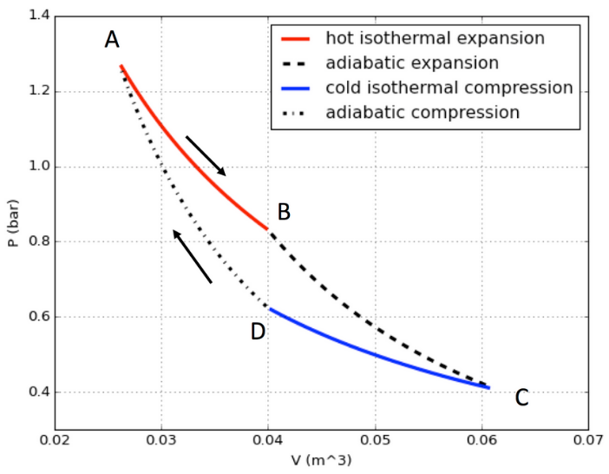

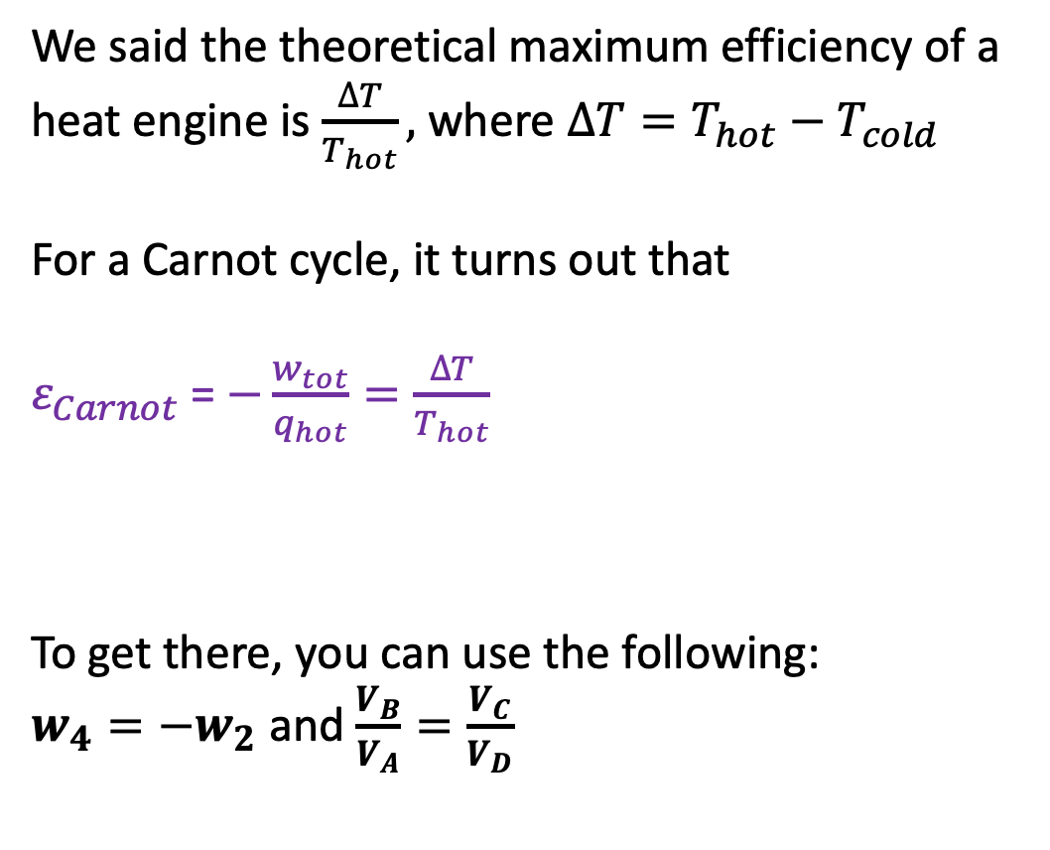



5. Show that the Carnot cycle’s efficiency really is the theoretical maximum
We said the theoretical maximum efficiency of a heat engine is $\frac{∆T}{T_{hot}},$where $∆T=T_{hot}−T_{cold}$
For a Carnot cycle, it turns out that
$ε_{Carnot}$= $−\frac{w_{tot}}{q_{hot}}=\frac{∆T}{T_{hot}}$
To get there, you can use the following:
$w_{4}=−w_{2}$ and $\frac{V_{B}}{V_{A}}=\frac{V_{C}}{V_{D}}$
$$w_{1}$$
$$w_{2}=−880 J$$
$$w_{4}=\text{+880 }\text{J}$$
?
$$w_{3}$$

